Slide 1
Prison Runner
GAM 110 Team 13
Genre: Survival Prison
Goal/Aim: Save everyone
Rules: Probability and randomness
Wildcard: Swinging

Slide 2
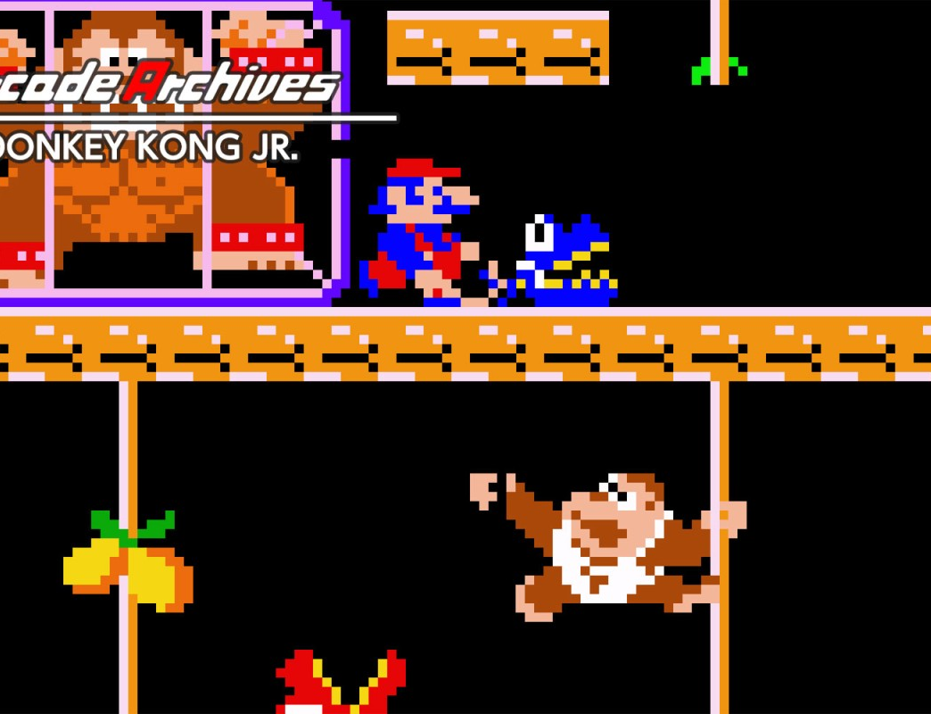
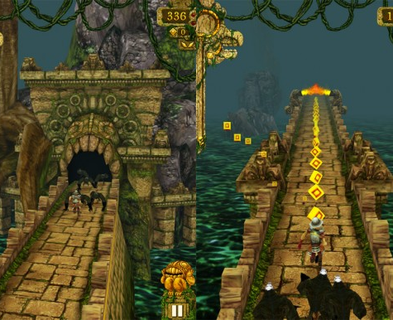
Design
Originally we were going to do Donkey Kong Jr style, but we ended up with an endless runner type style. We were planning for the character to swing on vines, but scrapped that idea due to lack of time.

Slide 3
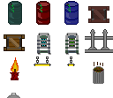

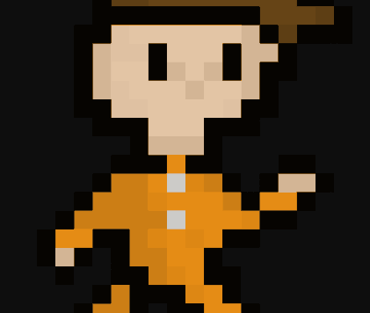
Art and animation
Our art and animation specialist worked closely to get the art and animation done for our game.

Slide 4
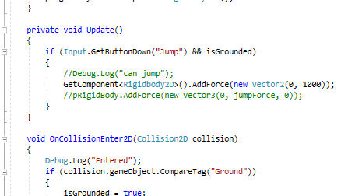
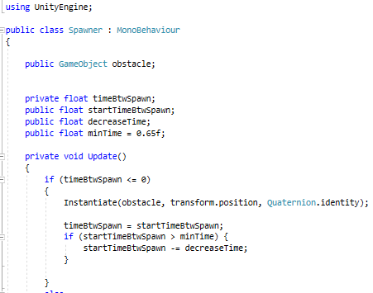
Programming
With only two programmers, there was a lot of code to do, but thankfully our designers stepped up to help make the code for our game.

Slide 5
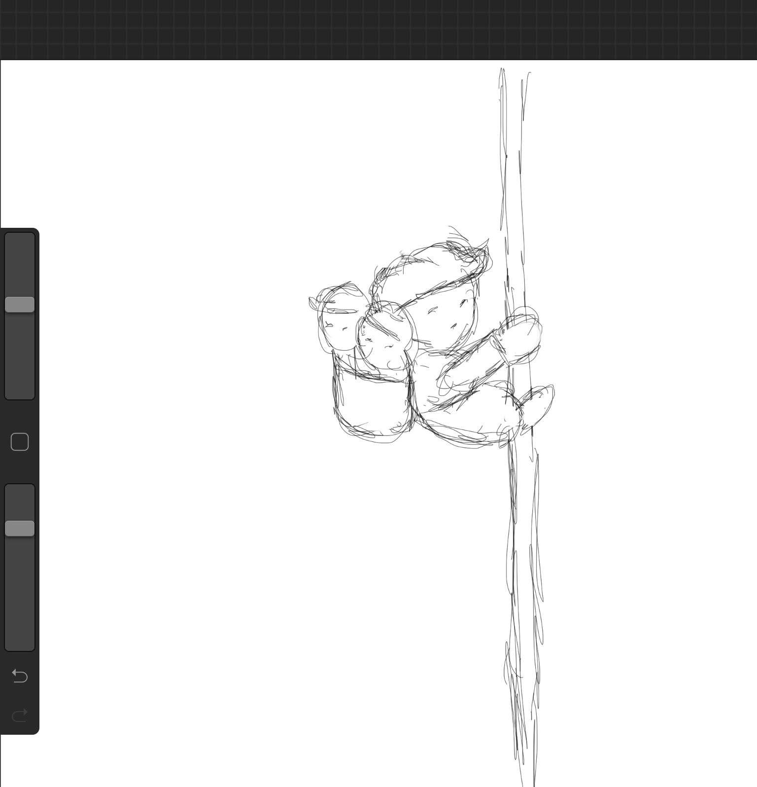
The lost cards
Due to time constrains we were not able to fulfil all of our creative cards, we wanted to add in a swinging mechanic that would allow the player to swing over large gaps. We also wanted to implement as system were you could save people while running away from the fire.

Slide 6
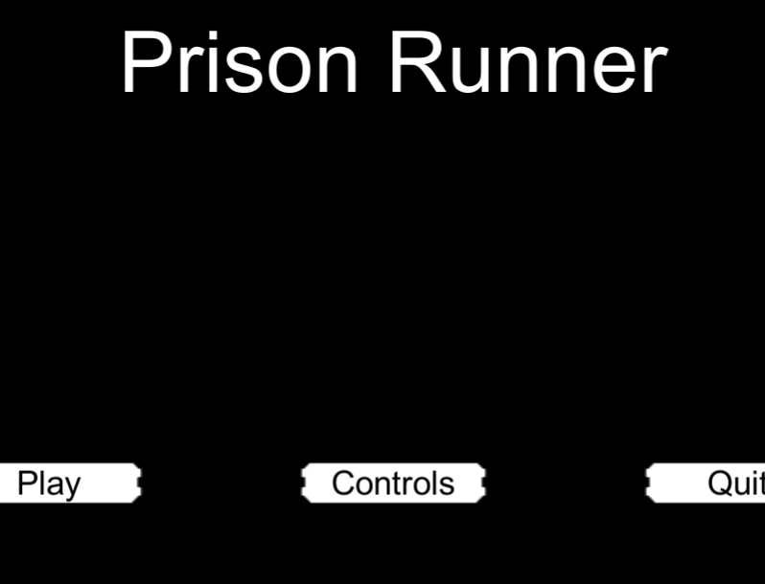
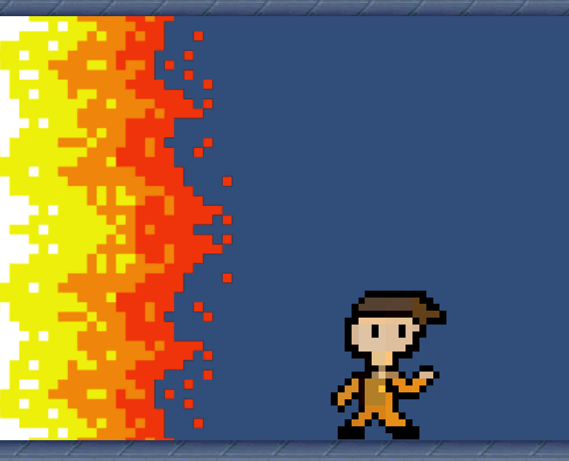
Our Game
We made a game, somehow. We over scoped a lot for the time we were given and a lot of small things took longer to do than we thought. So near the end we had to scrap a lot of features we wanted to include, with this we also loss a few of the creative cards.

